Slide 1


The circle and circumference in art and life

Slide 2
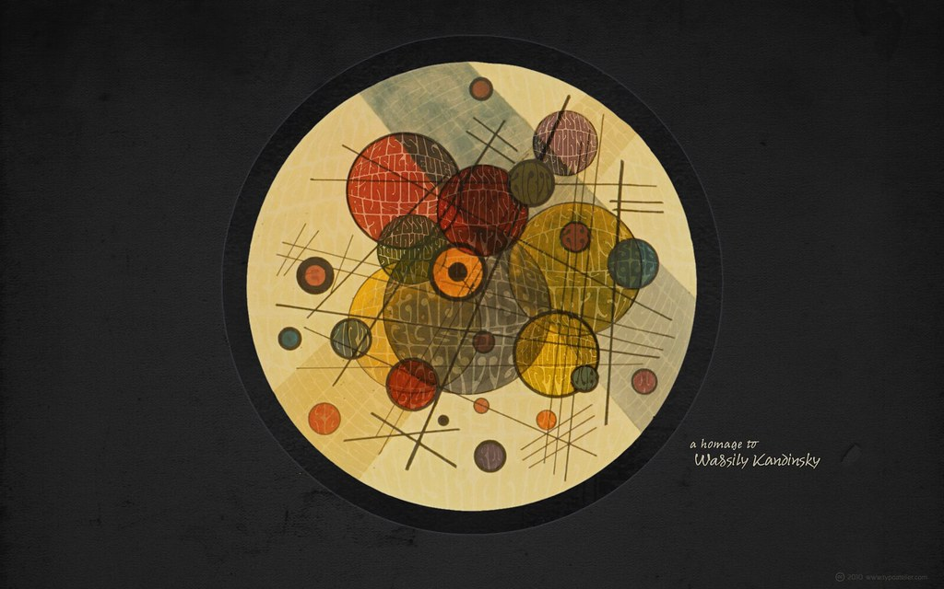
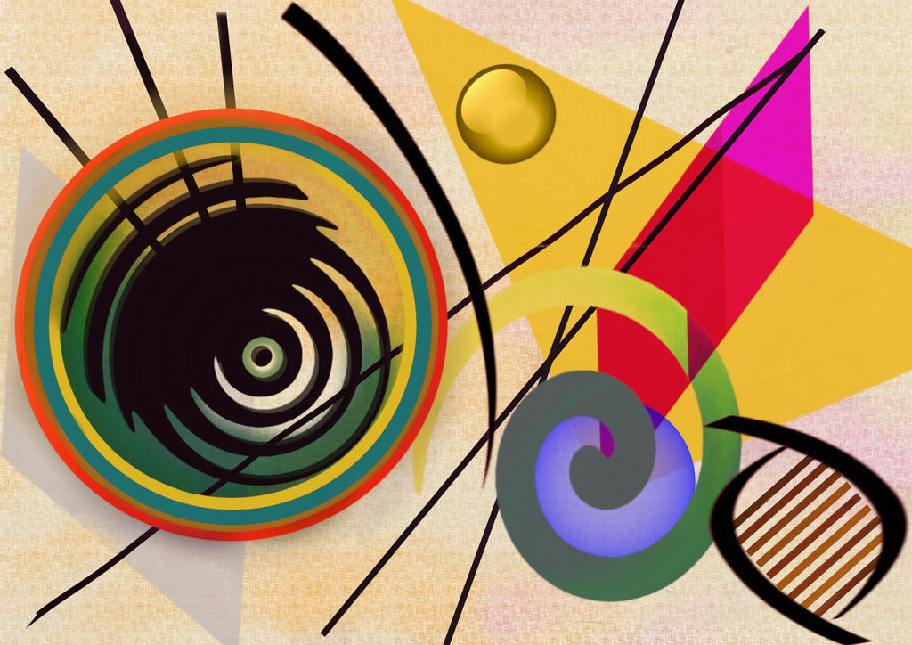
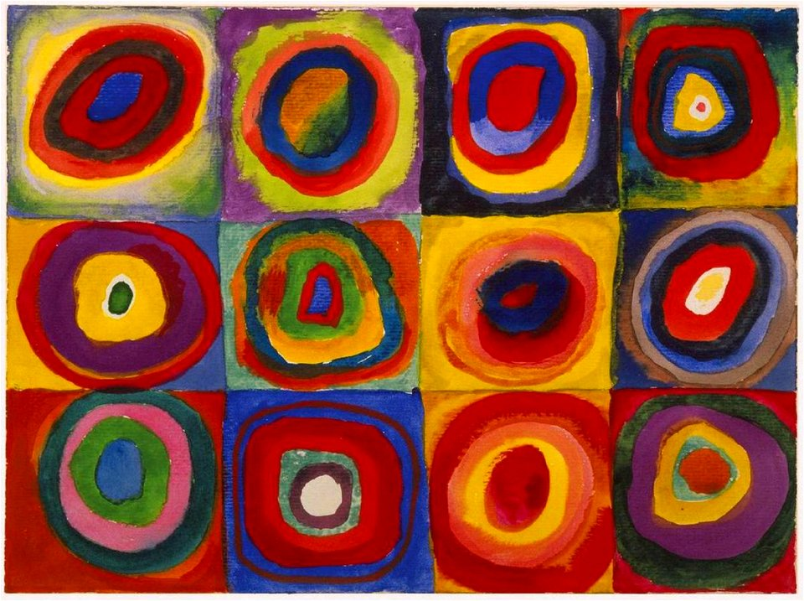
…in art
Kandinsky
EN Power project 2022-1-BG01-KA220-SCH-00085065

Slide 3
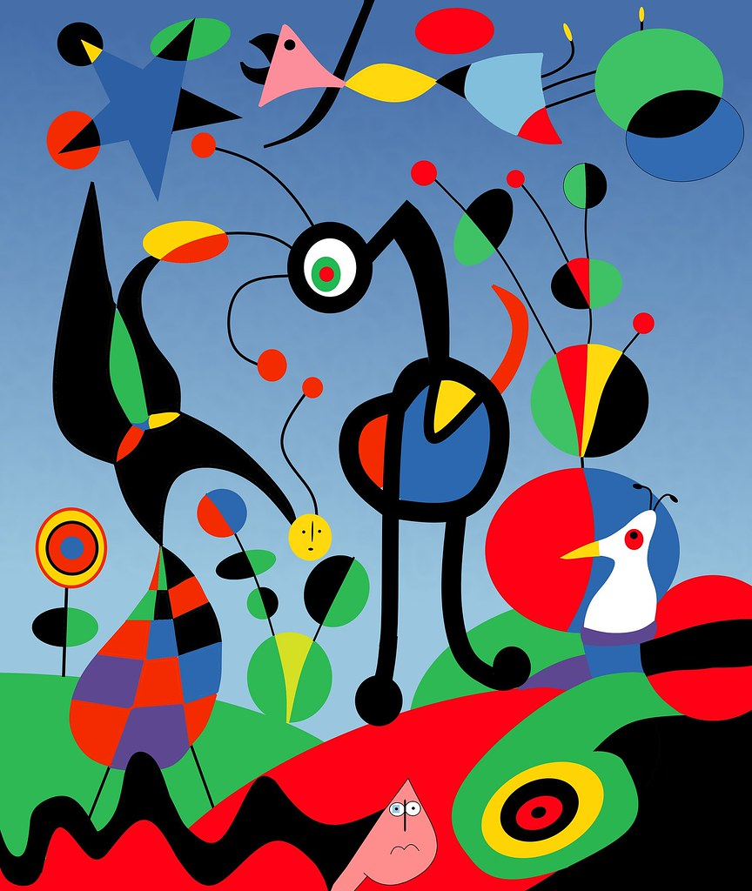
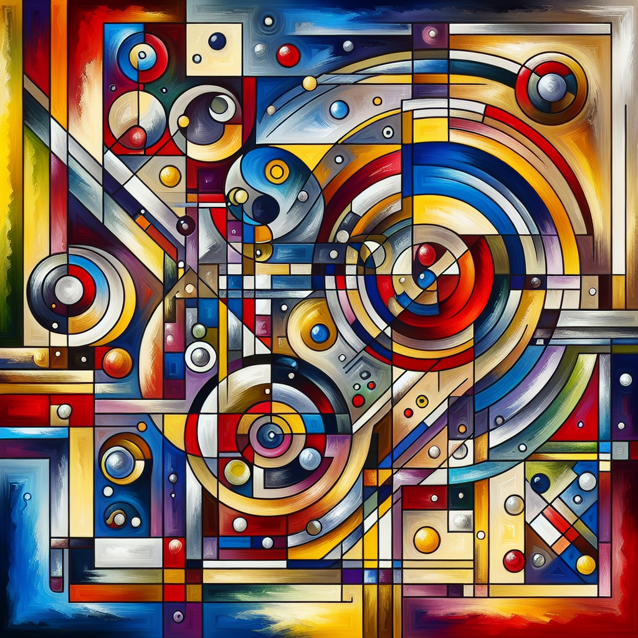
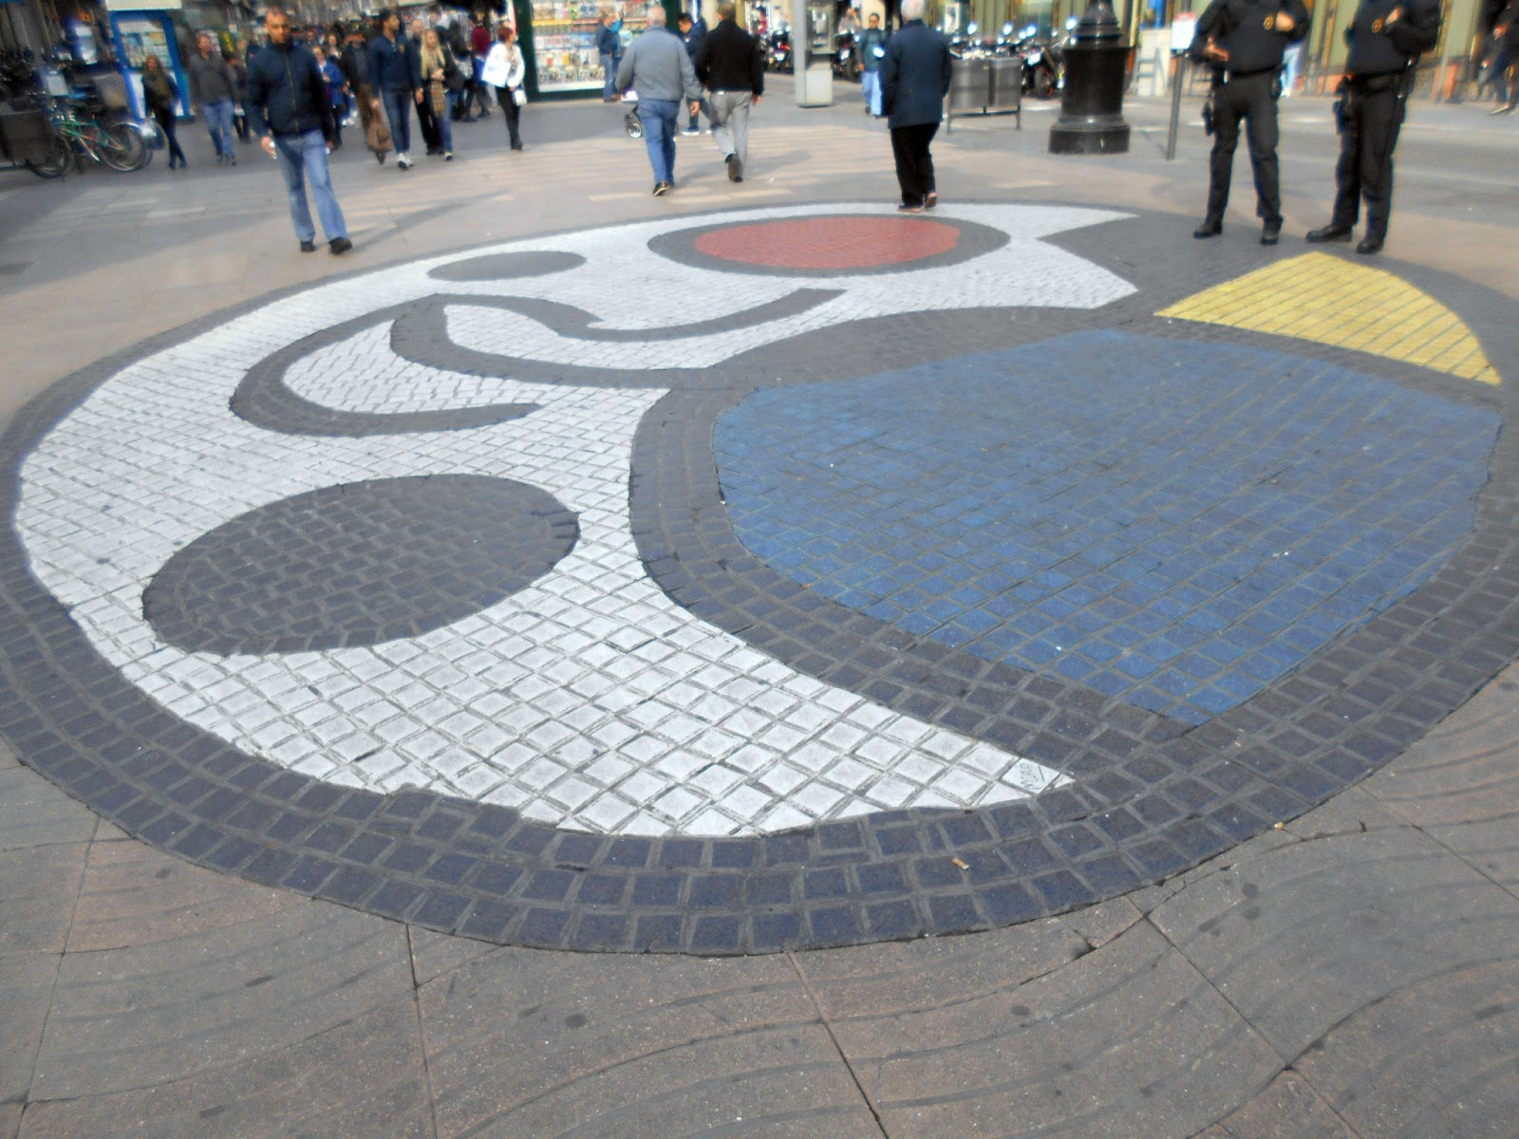
Miró
EN Power project 2022-1-BG01-KA220-SCH-00085065

Slide 4
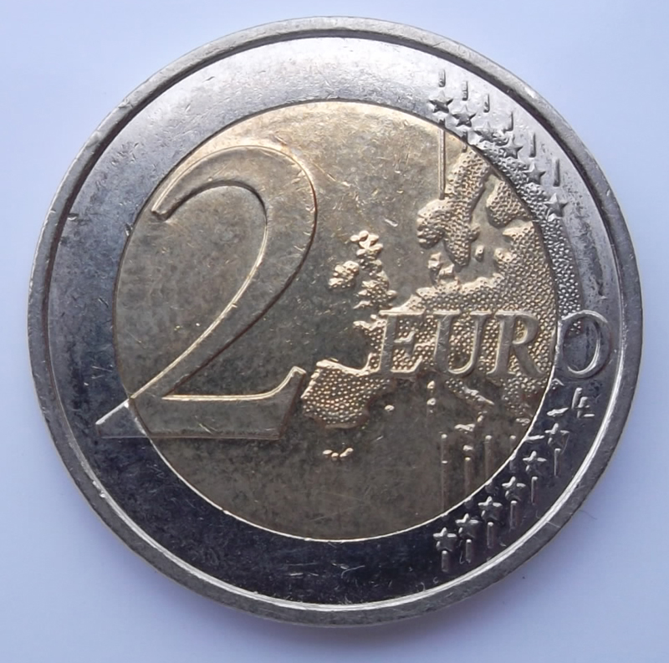
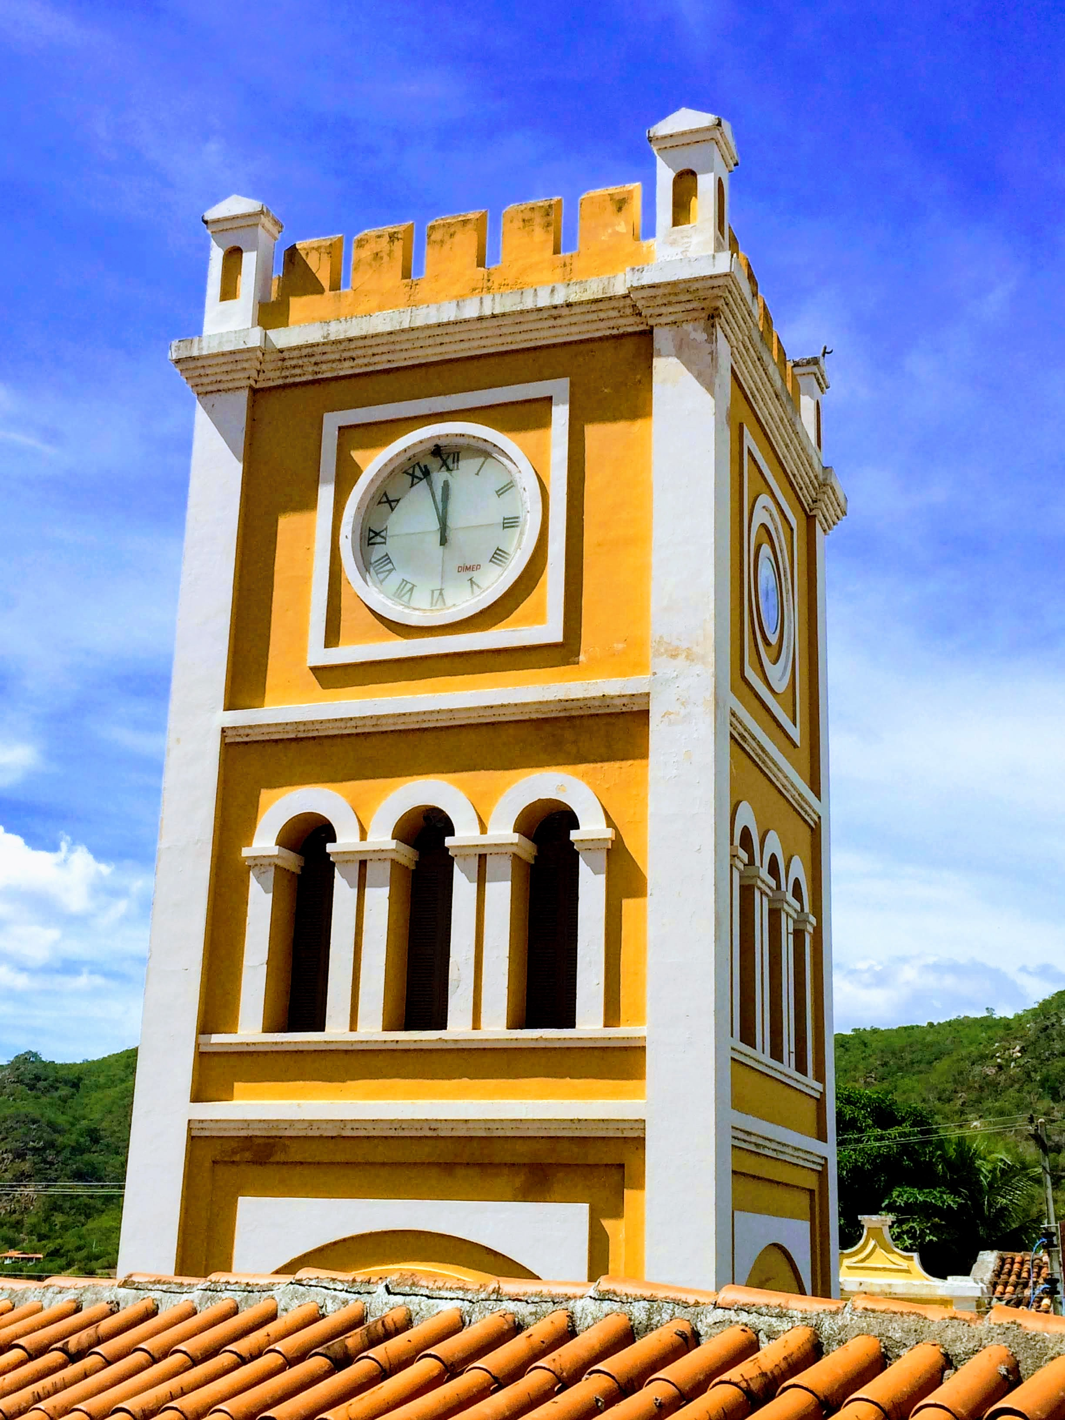
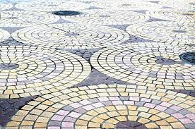
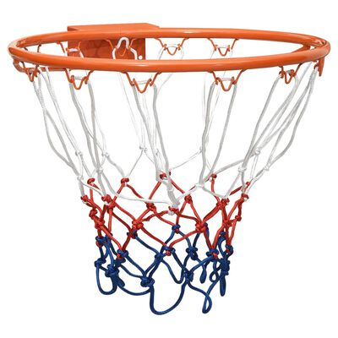

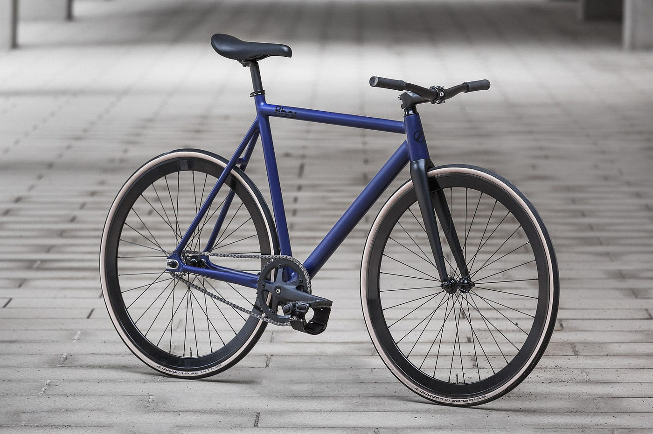
…in life
EN Power project 2022-1-BG01-KA220-SCH-00085065

Slide 5
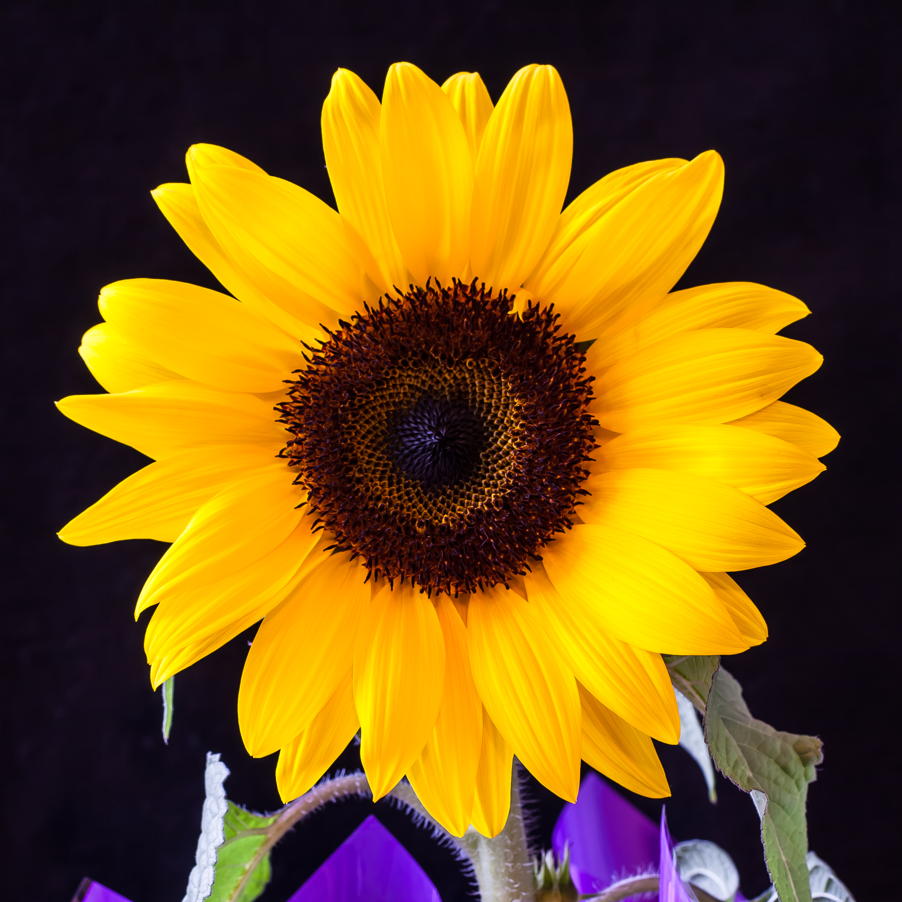
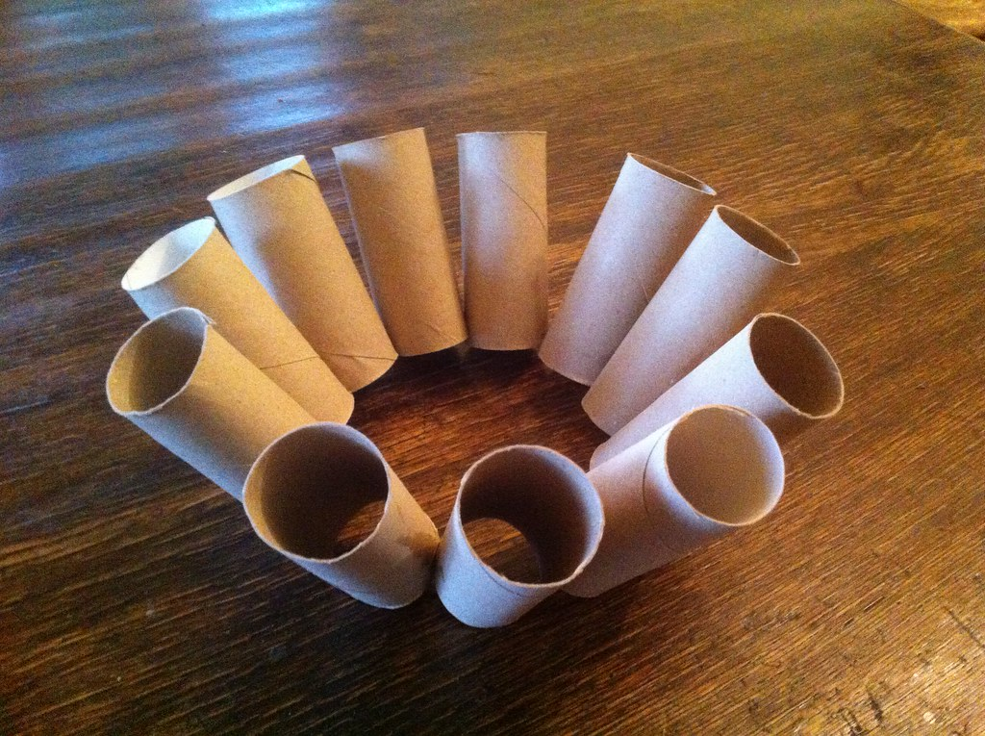
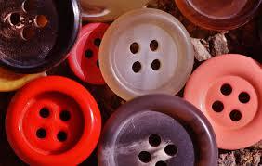
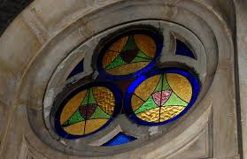
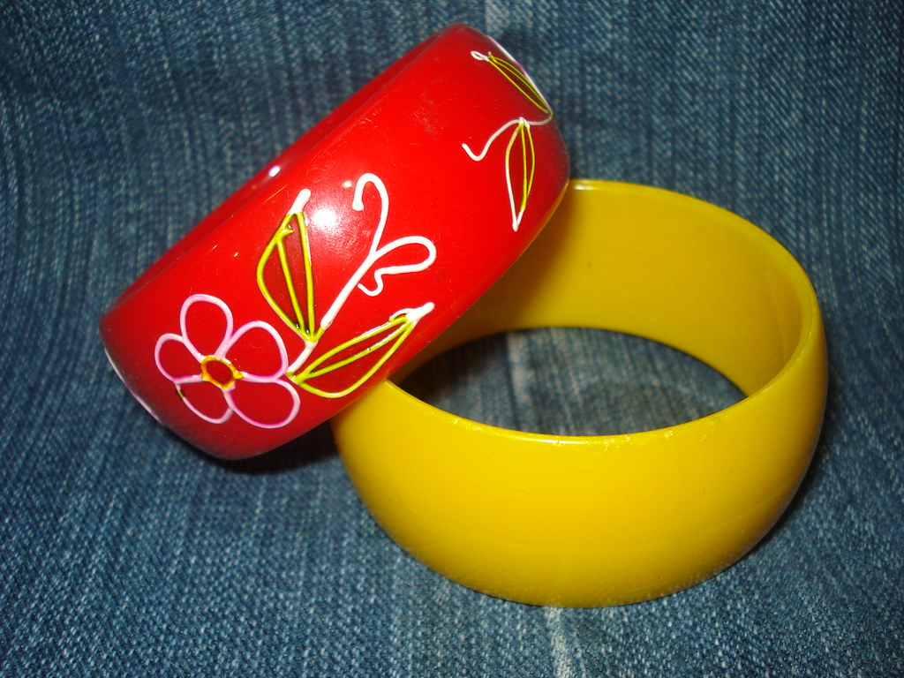
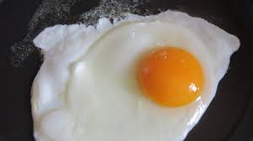
EN Power project 2022-1-BG01-KA220-SCH-00085065

Slide 6






2022-1-BG01-KA220-SCH-000085065
Subject: Maths
Age of students: 9 – 10 years old
Topic: Geometry and Measurement
Resource Title: The circle and circumference in art and life
Credits: AECE – Escola Básica da Zona Verde
All media are within the EU intellectual property law.
The European Commission’s support for this publication does not constitute an endorsement of the contents, which reflect the views only of the authors, and the Commission cannot be held responsible for any use which may be made of the information contained herein.

